Slide 1
Welcome!
Notes:
Welcome!
Instructor: Thank everyone for participating in the survey. Acknowledge and thank any policy team members present. Conduct group introductions if appropriate.

Slide 2
Why address distracted driving in the workplace?
We need your support to shift toward a culture of safe, responsible driving at work and throughout our communities.
Notes:
Why are we addressing distracted driving at work? We need your support to shift toward a culture of safe, responsible driving at work and throughout our communities. Complying with existing laws and regulations is essential, but our goal is to achieve higher levels of safety by going beyond compliance to commitment – a commitment to safety for yourself and for others.

Slide 3
Distracted driving is…?
Notes:
How would you define distracted driving? Let’s find out!
Instructor:
Distribute index cards and pens to participants.
Follow instructions on “ANCHOR” Activity: Think-Pair-Share.
Total activity time: 10 minutes.

Slide 4
Definition of Distracted Driving:
Distracted driving is defined as driving while attempting to do ANY number of activities that take the driver’s attention away from the task of driving.
Notes:
There was a study of hundreds of drivers using cameras mounted in the vehicle. The study was able to capture what was happening just before crashes occurred. The study was able to determine the level of risk for being in a crash based on different distracting behaviors.
The major distraction subcategories observed in crash events were:
In-vehicle device (radio, climate control, other)-Moderate Risk
Cell hand-held (dialing, texting, talking)-High Risk
Reading/writing (includes tablet)-High Risk
Eating-Moderate Risk
Drinking (non-alcohol)-Moderate Risk
Personal hygiene-Moderate Risk
Reaching for an object (non-cell phone)-High Risk
Dancing in seat to music-Moderate Risk
Extended glance duration to external object-High Risk

Slide 5
Our priorities include:
Drivers never drive distracted – to protect passengers and bystanders.
Speak up if you are with a driver who is distracted.
Employees should encourage co-workers, friends, and family to drive distraction-free.
Notes:
Instructor: Distribute copies of your new workplace policy for reference. Give participants time to read the policy.
Be prepared to share information on:
Implementation timeline (When does it or did it go in eﬀect?)
Enforcement (Who will be enforcing the policy? What will be involved? Are there sanctions for noncompliance?)
Feedback (How would managers or leaders like to
receive feedback on the policy once it is in place?)
Set Manager/Supervisor commitment to not expect calls to be answered when someone is driving or assign employees to participate on handsfree conference calls while they are driving.

Slide 6
What do we have to do differently to operationalize the policy for individuals, for departments, for our workplace, for our community?
Growing a Culture of Safety
Community
Workplace
Department or Division
Individual
Notes:
Instructor: Distribute copies of your new workplace policy for reference. Give participants time to read the policy.
Be prepared to share information on:
Implementation timeline (When does it or did it go in eﬀect?)
Enforcement (Who will be enforcing the policy? What will be involved? Are there sanctions for noncompliance?)
Feedback (How would managers or leaders like to
receive feedback on the policy once it is in place?)
Set Manager/Supervisor commitment to not expect calls to be answered when someone is driving or assign employees to participate on handsfree conference calls while they are driving.

Slide 7
Growing a Culture of Safety
EVERYONE is involved in promoting a safe, responsible culture.
This culture encourages EVERYONE to speak up and get involved in a situation when intervention is needed.
Notes:
As a driver, you can choose to drive focused every time.
What can you do to prevent distracted driving as a passenger?

Slide 8
To intervene, do so with:
CARE
CALM
CONFIDENCE
Notes:
Non-drivers who speak up about distracted driving should demonstrate:
CARE–Be clear that the other person’s safety is important to you.
CALM–Don’t become angry or agitated. Be clear and assertive, but not aggressive.
CONFIDENCE–Speak directly with knowledge of the
policy and what constitutes correct safer behavior.
“APPLY” Activity: What I see, What I say
I will be sharing four descriptions of various scenarios on the screen. These are all scenarios that could occur in our workplace, and you will each have an opportunity to practice how to respond with care, calm, and confidence. Each person in the group will have an opportunity to respond to one of the scenarios as the “intervening” non-driver, while another member of the group receives and responds to the intervention as the distracted driver. The other group members observe.
Instructor: Complete activity as described.

Slide 9
What I see:
You are a passenger in a vehicle, and the driver reaches for their mobile phone.
What I say:
Notes:
Instructor: Allow about 3 minutes for the first round.
When the first round of interventions is complete, ask the groups to change roles. Each will have the opportunity to be the distracted driver, the intervening non-driver, and the observer.
When everyone has switched their roles, advance the slide.

Slide 10
What I see:
Your manager mentions that they are going to review a report on their commute, since they always gets stuck in stop-and-go traffic between work and home.
What I say:
Notes:
Instructor: Remind participants they can reference the new workplace policy if they need to support their request for the driver to be focused.
Allow about 3 minutes then ask the groups to switch roles again before advancing the slides.

Slide 11
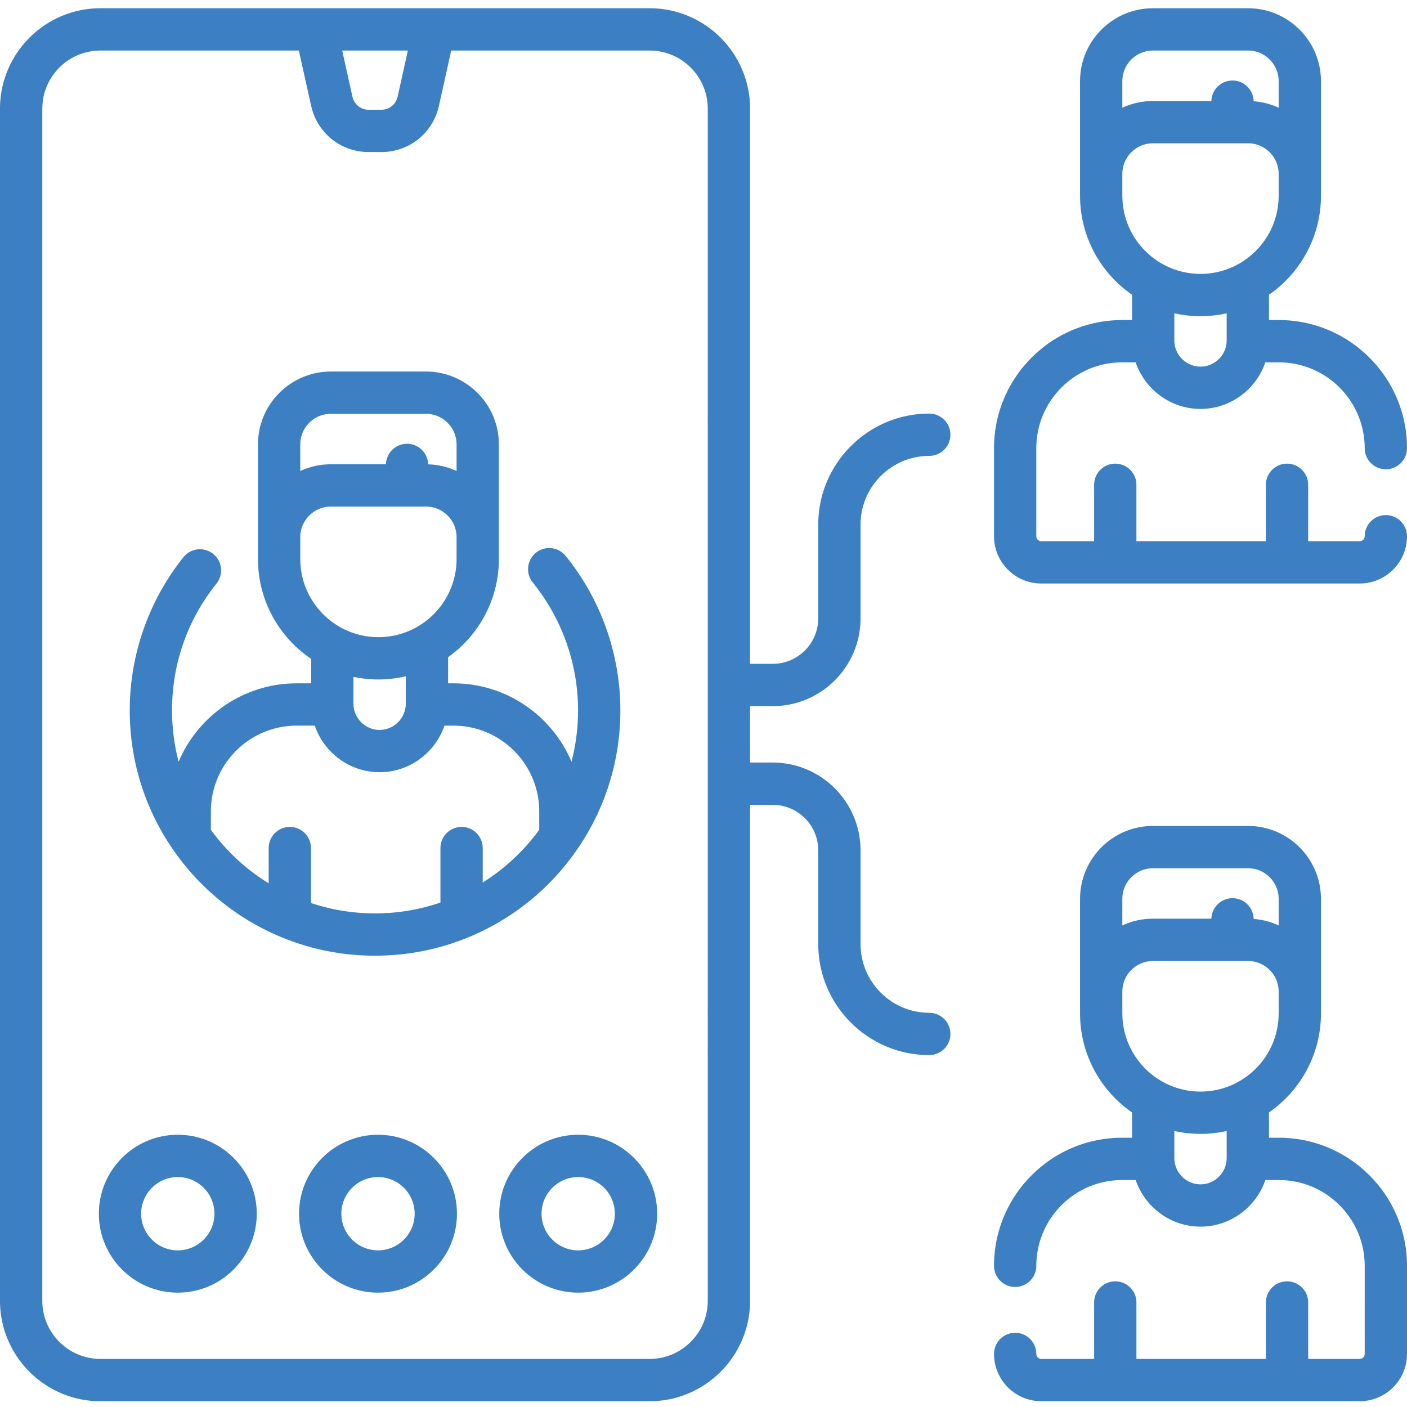
What I see:
Your coworker joins a conference call from their mobile phone while they are driving.
What I say:
Notes:
Instructor: Circulate around the room to hear how people are asking their driver to be focused on driving. Note strategies that are particularly novel or unusual to possibly share with the larger group as part of the activity debrief.
Allow about 3 minutes then ask the groups to switch roles one last time before advancing the slides. Some people may have more than one chance to practice.

Slide 12
What I see:
Your department manager is running late and mentions that they plan to eat lunch on the road to get to their next appointment on time.
What I say:
Notes:
Instructor: Allow about 3 minutes then call the attention back to the larger group.
Use these Activity Debrief Prompts to conclude the activity:
How were any of these scenarios similar to situations you have experienced in real life?
How did it feel to be the person intervening in these situations?
What made intervening difficult for you?
How did it feel to be the person receiving an intervention?
What did you observe during the activity?
Instructor: If time allows, go through each of the four scenario slides again. Display each scenario on the screen and ask for a volunteer to share what some of the responses were in their group. Discuss some of the best ways and specific challenges they found for each.

Slide 13
To have a workforce of engaged drivers, we ALL need to speak up if we know someone is driving distracted or is about to. Regardless of role, rank, or position, everyone in the organization should feel comfortable speaking up about engaged driving.
Notes:
While this may have been somewhat uncomfortable, this activity was intended to increase your confidence to address a distracted driver in the future. After this exercise, how do you expect to feel when you find yourself in a similar situation in real life?
Instructor: Acknowledge the novel or creative ways participants asked their ‘drivers’ to be focused and thank everyone for participating.

Slide 14
Tools for Reducing Distracted Driving
Create a voicemail announcing you are a “distraction-free” driver.
Begin conference calls by asking if anyone is in the car. If so, insist the driver pull over or call back when at a safe location.
Don’t schedule phone calls or meeting during your travel time.
Add travel time to your work calendar so that others know not to schedule a meeting during that time.
Establish specific times when you are available to make and take calls.
Notes:
Here are some strategies to help you be a safer and focused driver.
Instructor: You can ask for volunteers to read the different tips. Asking for multiple readers increases attention and engagement of your audience.

Slide 15
Establish an expectation among leadership that they will not call their staff or expect staff to answer their calls while driving.
Shut off your phone or put it in “airplane mode” before starting the vehicle.
Assign 5 or 10 minutes before you drive to take care of final tasks (making or taking calls, eating, checking maps) so your in-car time is distraction free.
Place your phone physically out of reach (e.g., in backseat or trunk) before starting the vehicle.
On longer trips, build in “communication breaks” every 2-3 hours to make or take calls, send emails, and complete other tasks.
Notes:
Instructor: Distribute “APPLY”: Tools for Reducing Distracted Driving.
Use this handout to remember all the ways you can reduce the risk of distraction when driving. Share these tools with friends and family to encourage focused driving throughout our community.
You might ask for other ways employees can improve their focused driving. If time allows, discuss what strategies will also work for families or friends. Different or additional strategies might emerge.

Slide 16
Make a commitment to drive focused and to speak up in situations to prevent distracted driving.
Notes:
We have covered our new distracted driving policy to affirm our commitment to achieve higher levels of safety by going beyond compliance to commitment – a commitment to safety for yourself and the safety of others.
We’ve identified common types of distraction and strategies for reducing the risk of distracted driving as supervisors and employees.
We’ve also practiced speaking up in situations where others might be at risk of distraction or driving distracted.
Thank you for helping us develop a culture of safe, responsible driving at work and throughout our communities.

Slide 17
Thank You!
Notes:
Your participation today has been appreciated!

